Slide 1
DIGITAL PORTFOLIO
STUDENT NAME: thameena
REGISTER NO AND NMID:948154cc86bf7d789714149eae04df4f
DEPARTMENT: Computer Science with Artificial Intelligence
COLLEGE: Lakshmi Bangaru Arts and Science College

Slide 2
DIGITAL PORTFOLIO PROJECT – PERSONAL PORTFOLIO WEBSITE

Slide 3
AGENDA
1.Problem Statement
2.Project Overview
3.End Users
4.Tools and Technologies
5.Portfolio design and Layout
6.Features and Functionality
7.Results and Screenshots
8.Conclusion
9.Github Link

Slide 4
PROBLEM STATEMENT
Many students and professionals struggle to effectively showcase their skills, projects, and achievements. Lack of a digital presence reduces opportunities for jobs, internships, and collaborations.

Slide 5
PROJECT OVERVIEW
A responsive and user-friendly website designed to highlight personal achievements, skills, and projects. It serves as a digital resume and portfolio to present to recruiters, companies, or clients.

Slide 6
WHO ARE THE END USERS?
*Students
*Job seekers
*Freelancers
*Hiring managers & recruiters

Slide 7
Students Job seekers Freelancers Hiring managers & recruiters
*Frontend: HTML, CSS, JavaScript
*Version Control & Deployment: Git, GitHub Pages

Slide 8
Frontend: HTML, CSS, JavaScript Version Control & Deployment: Git, GitHub Pages
*Home – Introduction & Profile
*About Me – Education & Skills
*Resume – Digital formate
*Projects – Work Showcase with Screenshots
*Blog – Share articles, coding journey, and insights
*Contact – Form + Links to Email, GitHub, LinkedIn

Slide 9
FEATURES & FUNCTIONALITY
*Responsive design (desktop & mobile)
*Resume download option
*Contact form with quick links

Slide 10
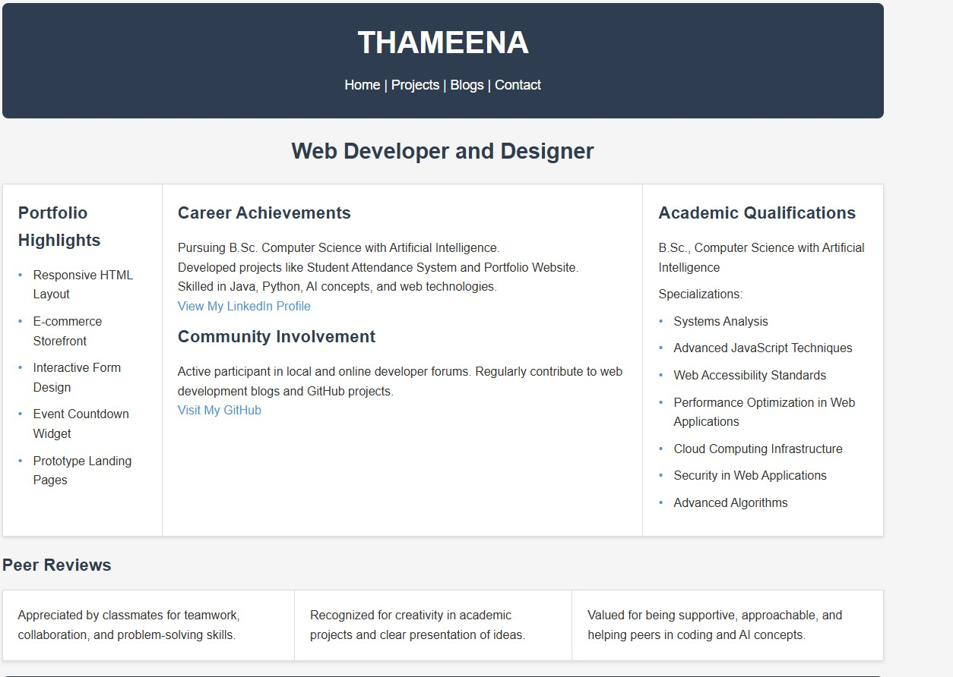
RESULTS & SCREENSHOTS

Slide 11
CONCLUSION
*Provides a professional online identity
*Helps in job applications, networking personal branding

